Slide 1
Linked List in C
Dr Vaidehi & Dr BJ Hubert Shanthan

Slide 2
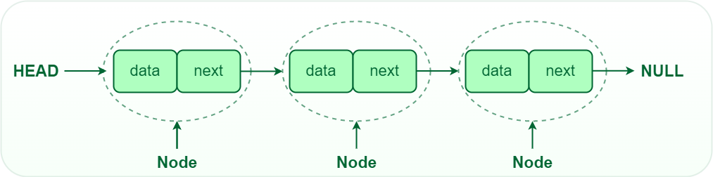
Linked List
A linked list is a linear data structure, in which the elements are not stored at contiguous memory locations. The elements in a linked list are linked using pointers.
Linked List is a linear data structure, in which elements are not stored at a contiguous location, rather they are linked using pointers.
Linked List forms a series of connected nodes, where each node stores the data and the address of the next node.

Slide 3
Linked List Components
Node Structure: A node in a linked list typically consists of two components: Data: It holds the actual value or data associated with the node. Next Pointer: It stores the memory address (reference) of the next node in the sequence. Head and Tail: The linked list is accessed through the head node, which points to the first node in the list. The last node in the list points to NULL or nullptr, indicating the end of the list. This node is known as the tail node.

Slide 4
Advantages of Linked List
Dynamic Data structure: The size of memory can be allocated or de-allocated at run time based on the operation insertion or deletion.
Ease of Insertion/Deletion: The insertion and deletion of elements are simpler than arrays since no elements need to be shifted after insertion and deletion, Just the address needed to be updated.
Efficient Memory Utilization: As we know Linked List is a dynamic data structure the size increases or decreases as per the requirement so this avoids the wastage of memory.
Implementation: Various advanced data structures can be implemented using a linked list like a stack, queue, graph, hash maps, etc.
Notes:
In a system, if we maintain a sorted list of IDs in an array id[] = [1000, 1010, 1050, 2000, 2040].
If we want to insert a new ID 1005, then to maintain the sorted order, we have to move all the elements after 1000 (excluding 1000).
Deletion is also expensive with arrays until unless some special techniques are used. For example, to delete 1010 in id[], everything after 1010 has to be moved due to this so much work is being done which affects the efficiency of the code.

Slide 5
Types of Linked List
Single-linked list
Double linked list
Circular linked list

Slide 6
Single Linked List
In a singly linked list, each node contains a reference to the next node in the sequence. Traversing a singly linked list is done in a forward direction.
A singly linked list is a linear data structure in which the elements are not stored in contiguous memory locations and each element is connected only to its next element using a pointer.

Slide 7
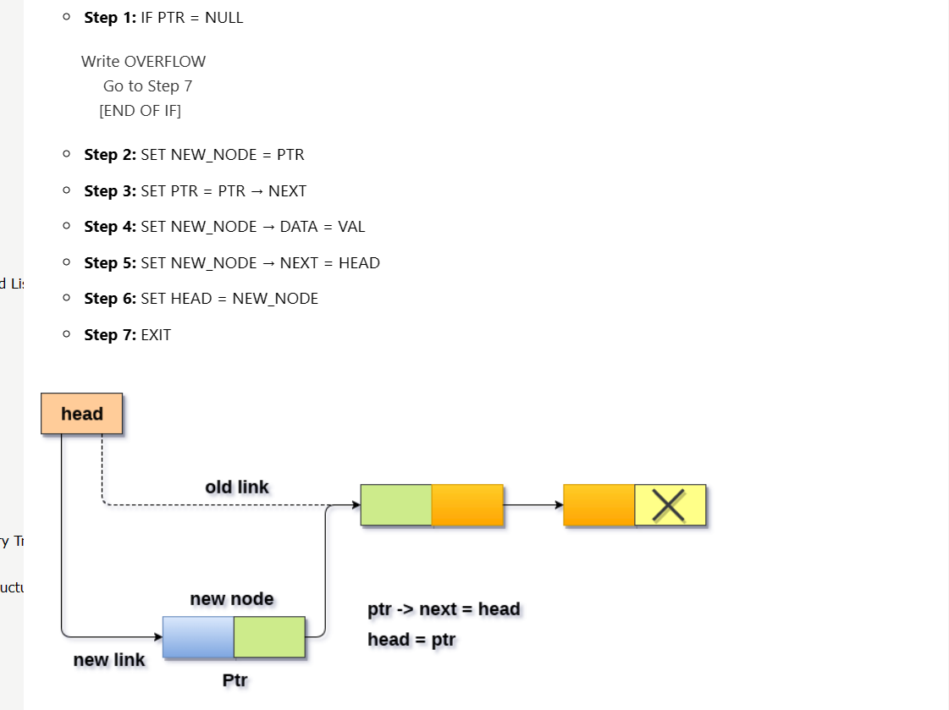
Single linked list at Beginning

Slide 8
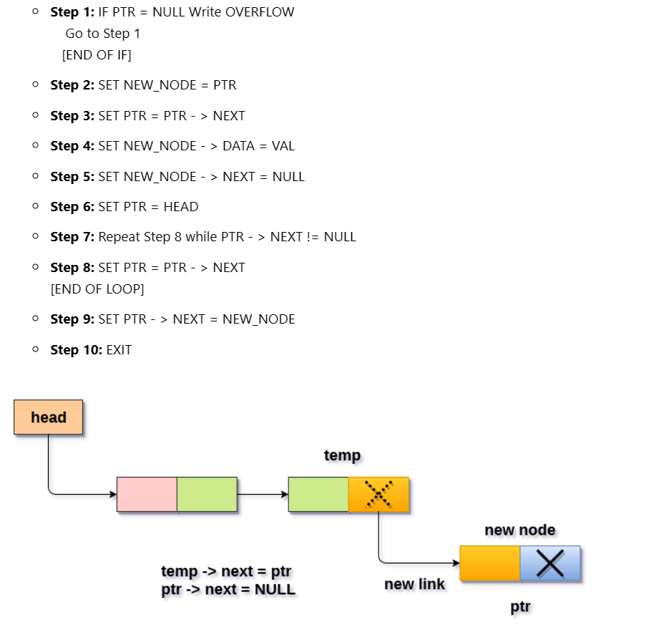
Single linked list at end
The node is being added to an empty list
The node is being added to the end of the linked list

Slide 9
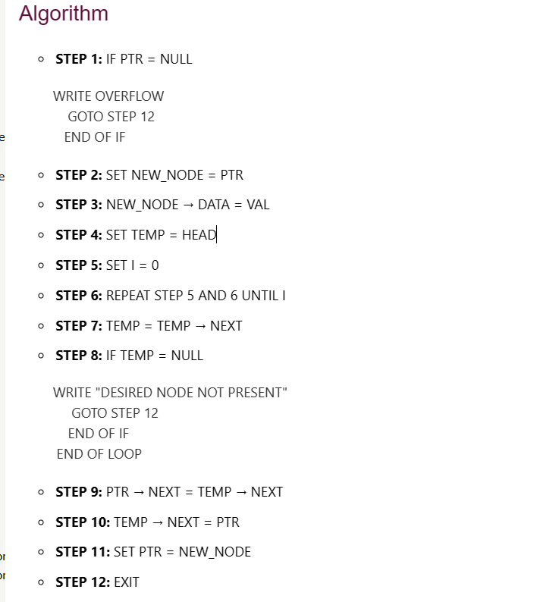
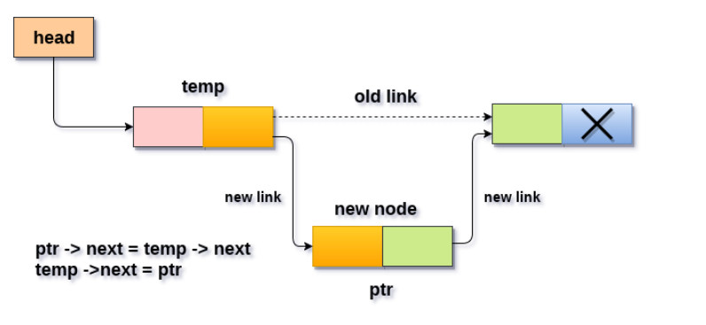
Insertion in between nodes single linked list

Slide 10
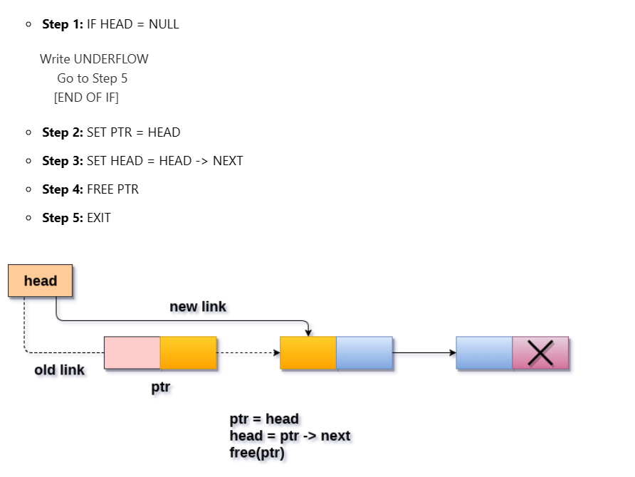
Deletion of Node in beginning single linked list

Slide 11
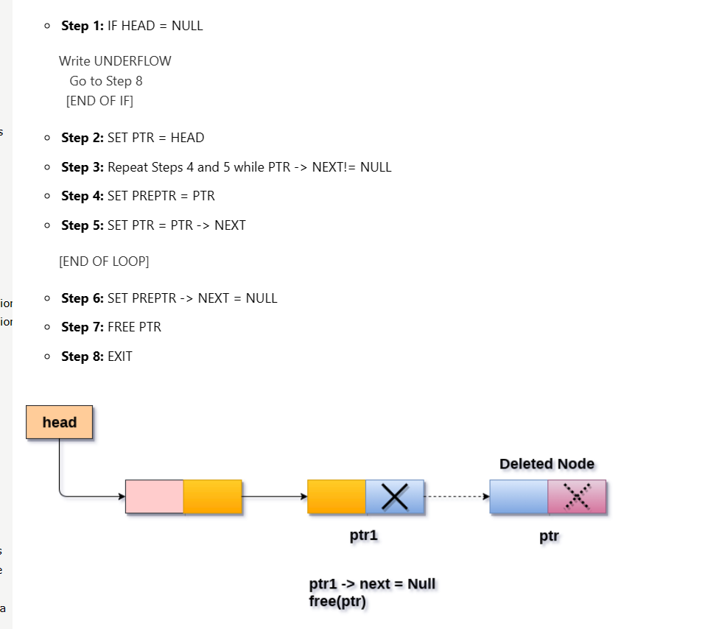
Delete at end single Linked List

Slide 12
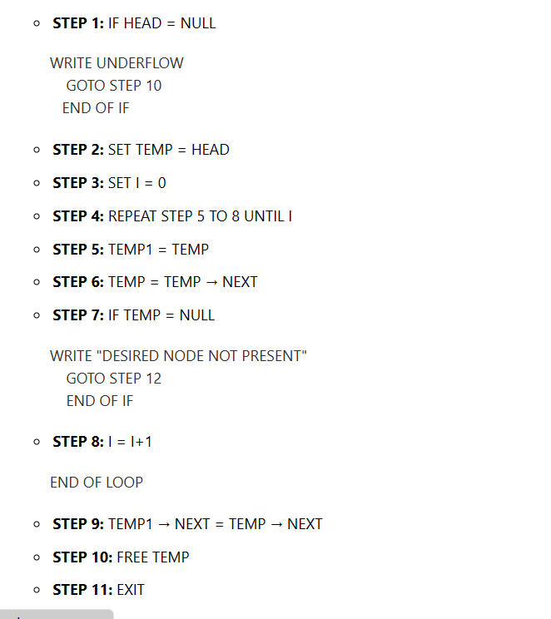
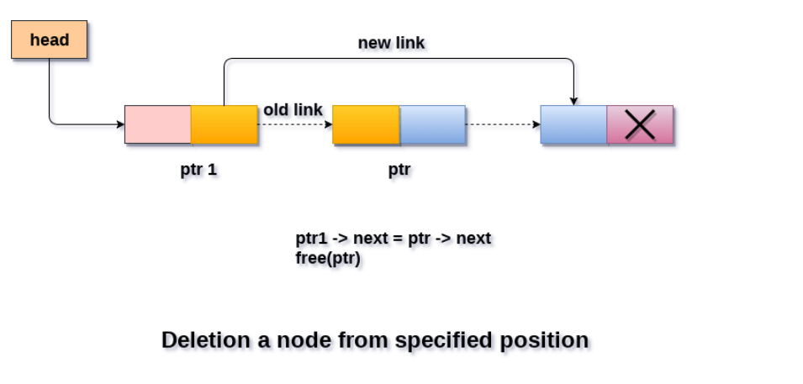
Delete specified node

Slide 13
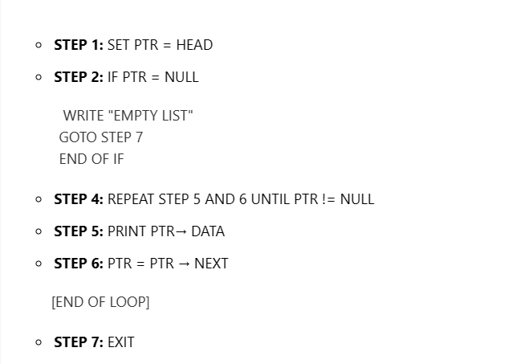
Traverse a Node in Single Linked List
ptr = head;
while (ptr!=NULL)
{
ptr = ptr -> next;
}

Slide 14
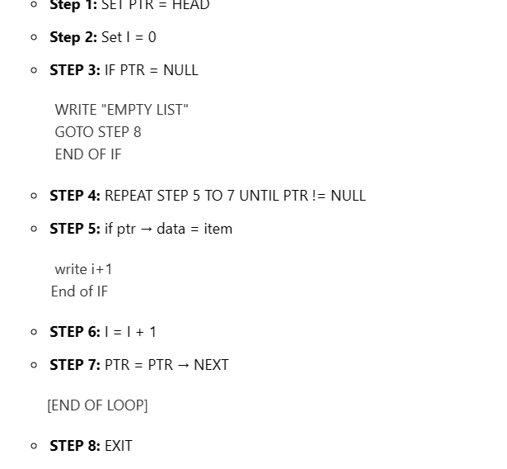
Searching a Node in single Linked List

Slide 15
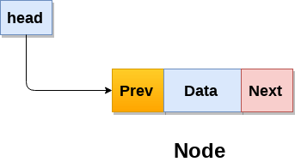
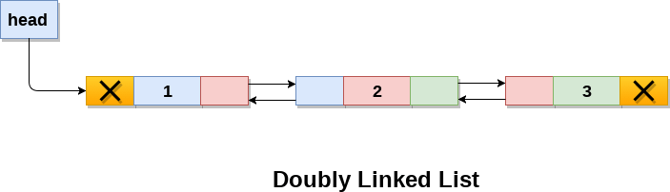
Double Linked List
Doubly linked list is a complex type of linked list in which a node contains a pointer to the previous as well as the next node in the sequence. Therefore, in a doubly linked list, a node consists of three parts: node data, pointer to the next node in sequence (next pointer) , pointer to the previous node (previous pointer).

Slide 16
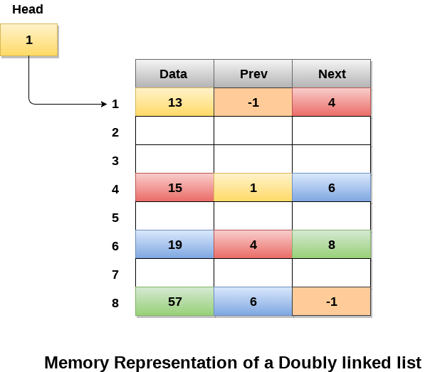
Memory Representation of Double Linked List

Slide 17
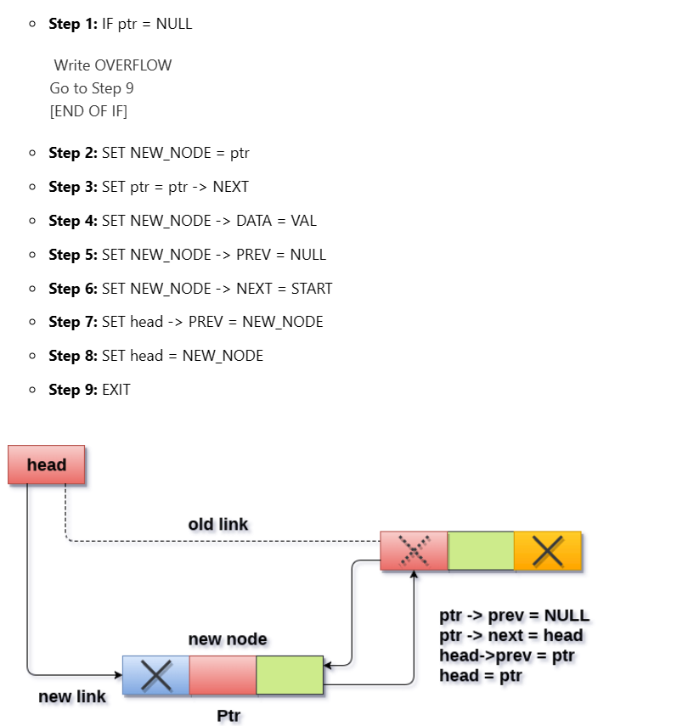
Insert at Beginning at Double Linked List

Slide 18
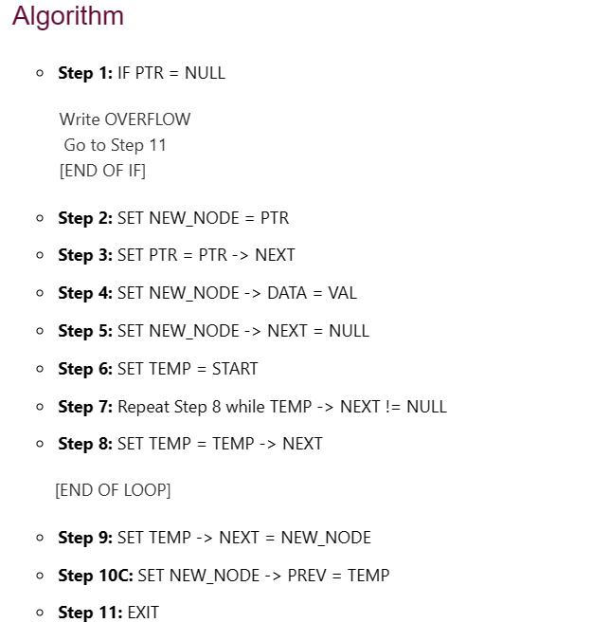
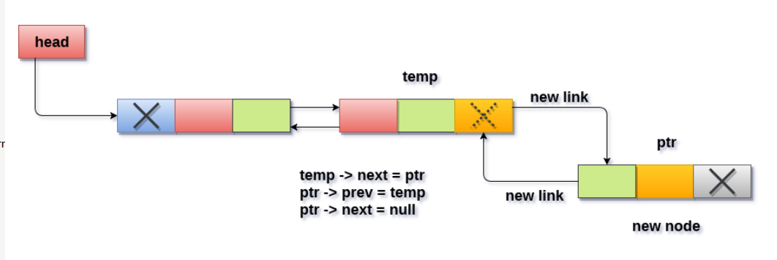

Slide 19
Insertion after specified node

Slide 20
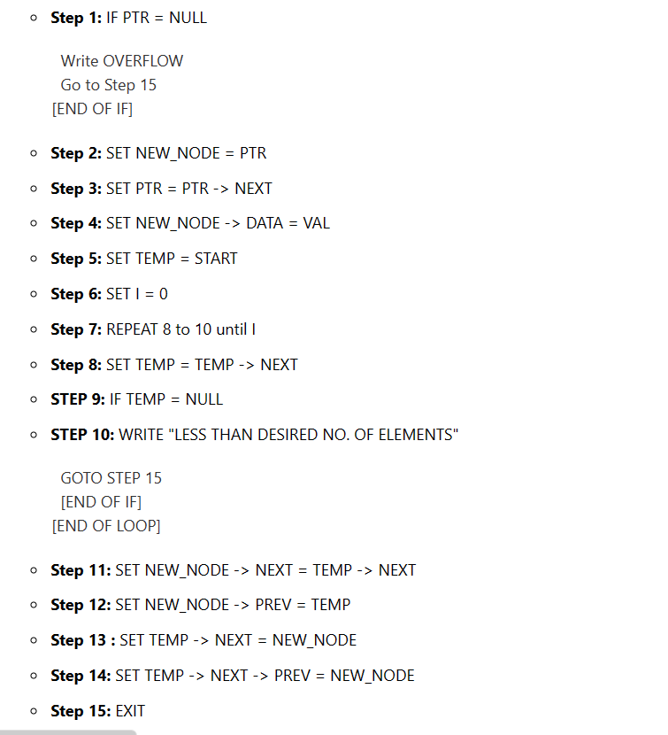
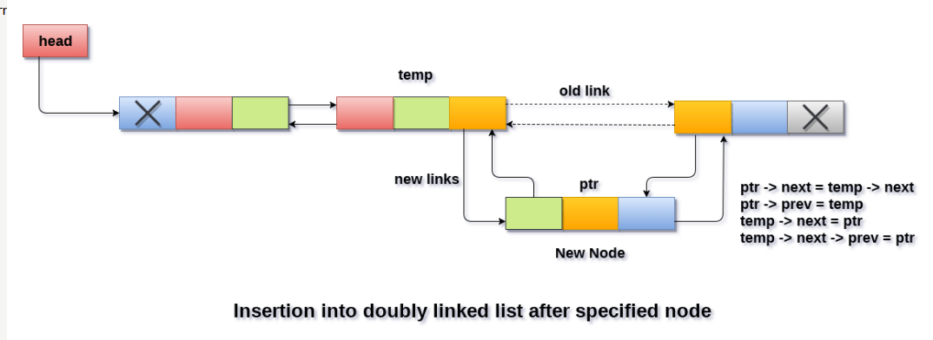

Slide 21
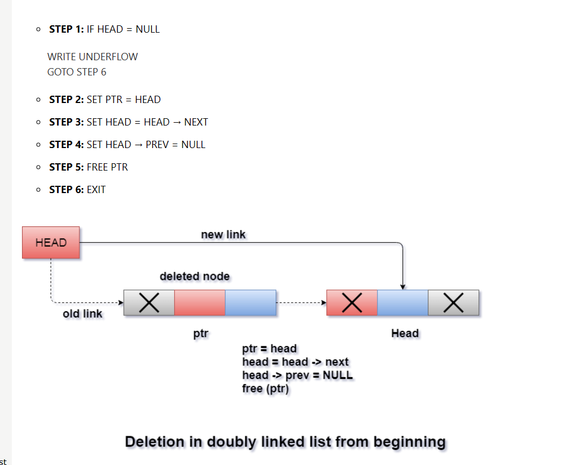

Slide 22
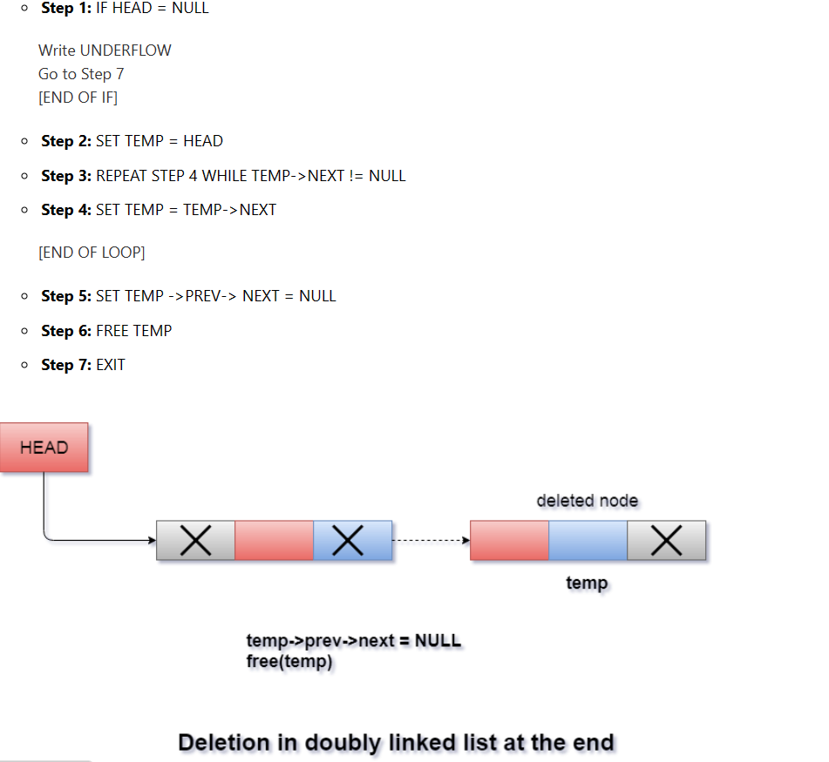

Slide 23
Deletion of specific node from double linked list

Slide 24
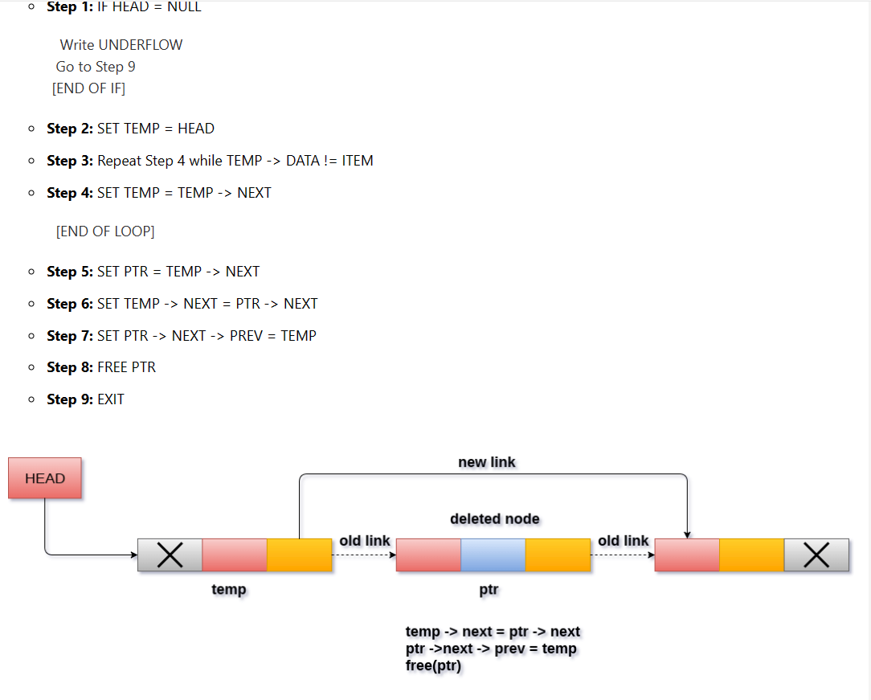

Slide 25
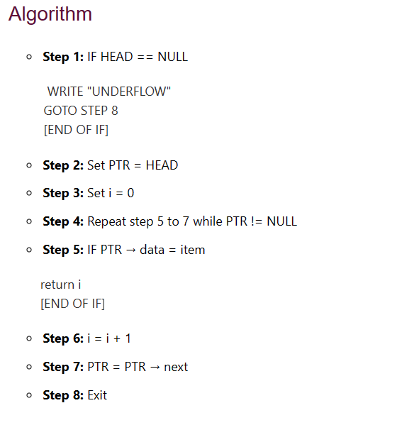
Searching for a specific node in Doubly Linked List

Slide 26
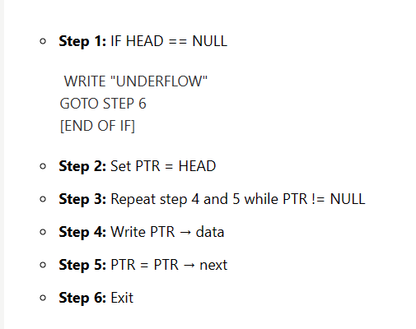
Traversing in doubly linked list

Slide 27
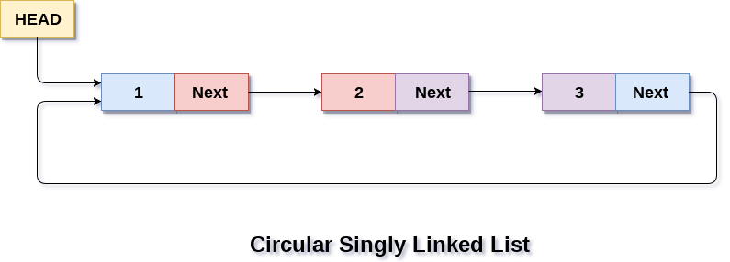
Circular Linked List
In a circular Singly linked list, the last node of the list contains a pointer to the first node of the list. We can have circular singly linked list as well as circular doubly linked list.
We traverse a circular singly linked list until we reach the same node where we started. The circular singly liked list has no beginning and no ending. There is no null value present in the next part of any of the nodes.

Slide 28
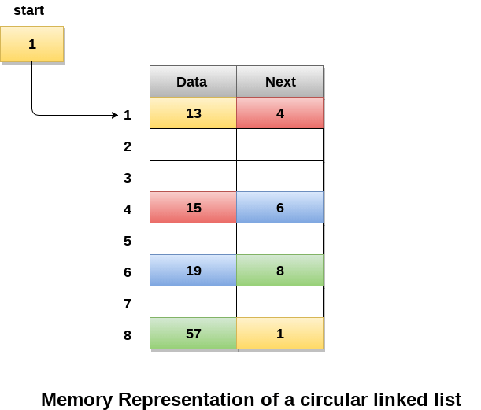

Slide 29
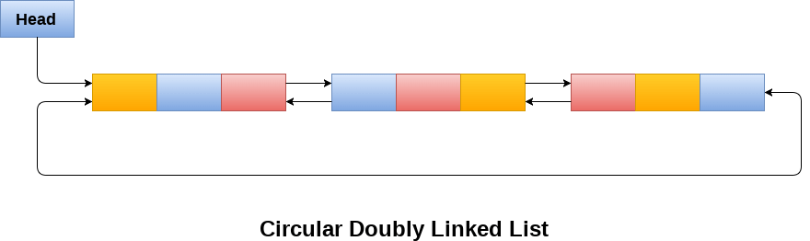
Circular Double Linked List
Circular doubly linked list is a more complexed type of data structure in which a node contain pointers to its previous node as well as the next node. Circular doubly linked list doesn't contain NULL in any of the node. The last node of the list contains the address of the first node of the list. The first node of the list also contain address of the last node in its previous pointer.

Slide 30
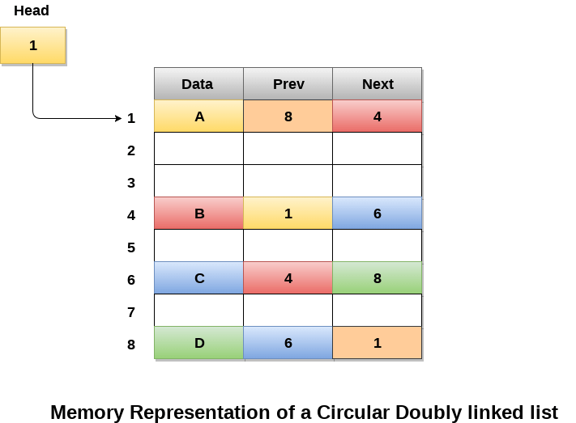

Slide 31
Applications of linked list:
Implementation of stacks and queues
Implementation of graphs: Adjacency list representation of graphs is the most popular which uses a linked list to store adjacent vertices.
Dynamic memory allocation: We use a linked list of free blocks.
Manipulation of polynomials by storing constants in the node of the linked list
Representing sparse matrices

Slide 32
Advantages of Singly Linked List
it is very easier for the accessibility of a node in the forward direction.
the insertion and deletion of a node are very easy.
the Requirement with less memory when compared to doubly, circular or doubly circular linked list.
the Singly linked list is the very easy data structure to implement.
During the execution, we can allocate or deallocate memory easily.
Insertion and deletion of elements don’t need the movement of all the elements when compared to an array.
Disadvantages of Singly Linked List
Accessing the preceding node of a current node is not possible as there is no backward traversal.
the Accessing of a node is very time-consuming.
Search is time consuming as one way traversal

Slide 33
Advantages and disadvantages of DLL
Advantages | Disadvantages
1. It is bi-directional traversal | 1. Increased memory usage
2. It is efficient deletion | 2. More complex implementation
3. Insertion and deletion at both ends in constant time | 3. It is slower traversal

Slide 34
Applications of Doubly Linked List:
used in navigation systems where both forward and backward traversal is required.
It can be used to implement different tree data structures.

Slide 35
Advantages of Circular Linked Lists:
Efficient operations: Since the last node of the list points back to the first node, circular linked lists can be traversed quickly and efficiently.
Dynamic size:
Ease of implementation:

Slide 36
Disadvantages of CLL
Complexity: complex insertion and deletion operations.
Memory leaks: If the pointers in a circular linked list are not managed properly, memory leaks can occur. This happens when a node is removed from the list but its memory is not freed, leading to a buildup of unused memory over time.
Traversal can be more difficult:
Lack of a natural end:

Slide 37
Applications of CLL
used to represent a ring or circular buffer, where new elements can be added and old elements can be removed without having to shift the entire list.

